Slide 1
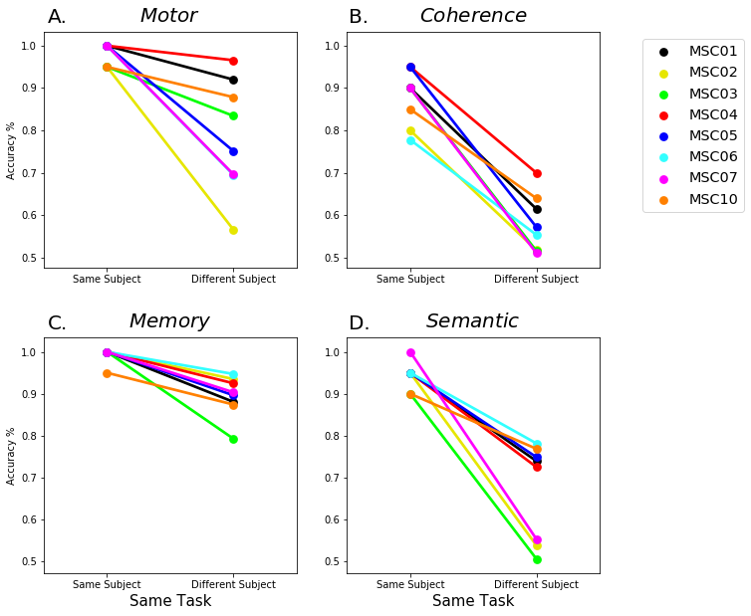
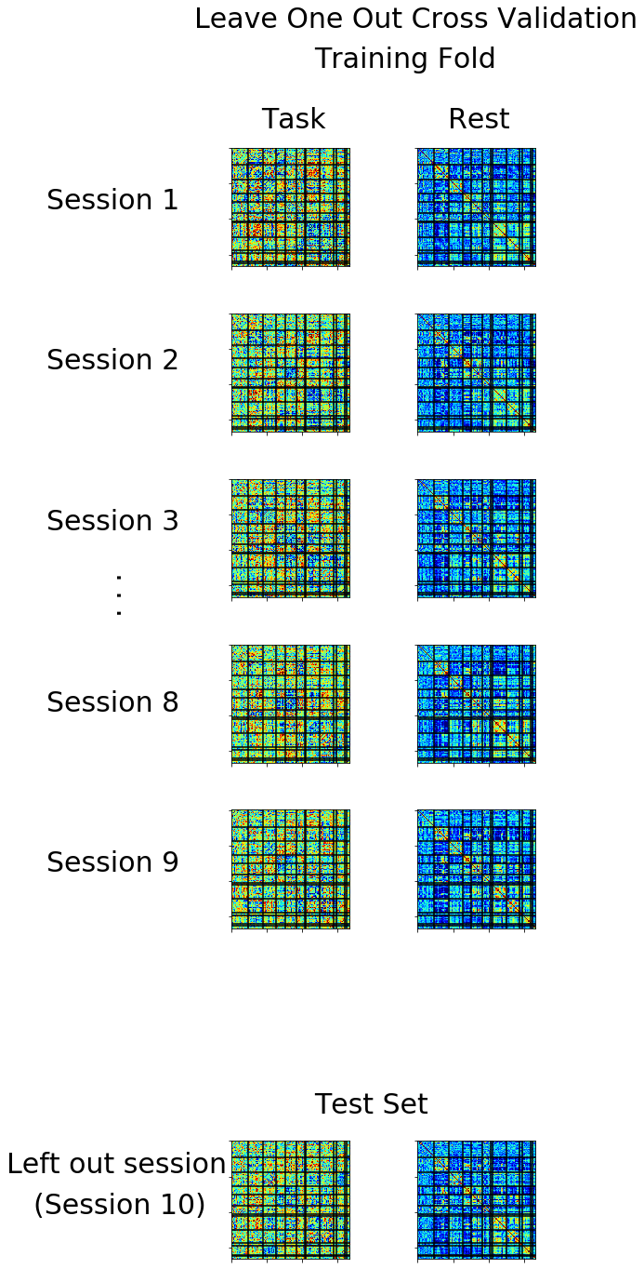
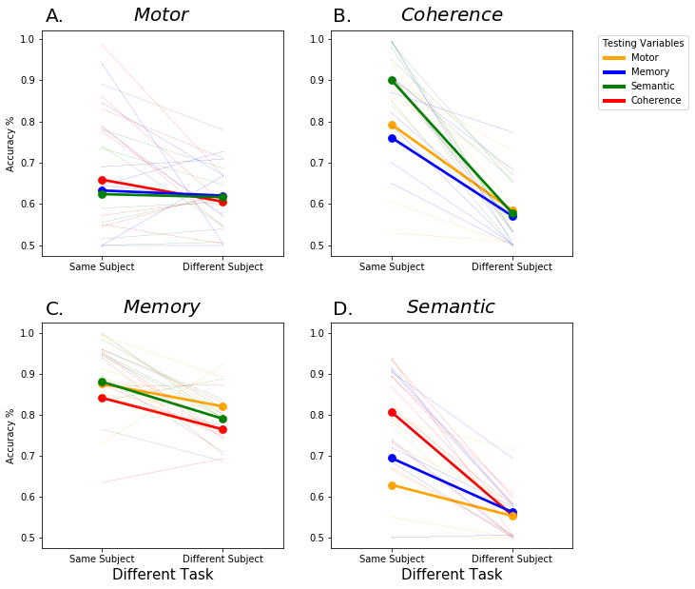
A.
Training
C.
Model Performance
Different Subject Same Task Test Sets
Midnight Scan Club
Semantic -MSC02
Individual Specific Analysis
4 Tasks x 10 Sessions x 10 Subjects
Classify
Semantic -MSC03
Semantic -MSC04
Memory
Motor
Semantic
Coherence
Testing Task FC
Testing Rest FC
Training Dataset
Classify
...
Fold 3
Fold 9
Fold 1
Fold 2
Fold 10
Individualized Classifiers
Task Generalizable Analysis
MSC01
MSC02
. . .
MSC10
Training Task FC
Training Rest FC
Testing Task FC
Testing Rest FC

